Slide 1

Rockbuster Stealth LLC online video rental service
Julian Klauder
January 2024

Slide 2

Objective
Key Questions for launch strategy:
Which movies contributed the most/least to revenue gain?
What was the average rental duration for all videos?
Which countries are Rockbuster customers based in?
Where are customers with a high lifetime value based?
Do sales figures vary between geographic regions?
Rockbuster is a movie rental company that used to have stores around the world. Due to stiff competition from streaming services, Rockbuster wants to launch an online rental service.

Slide 3
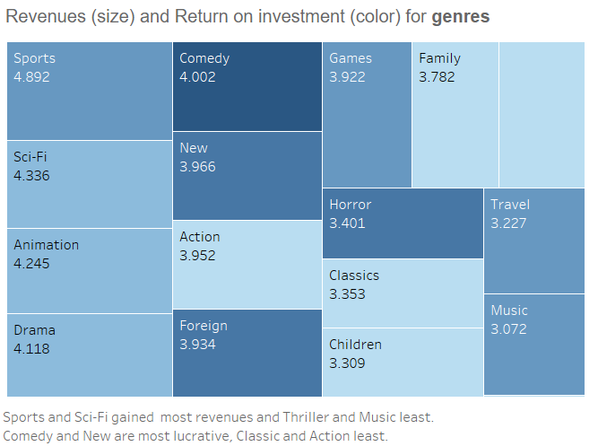
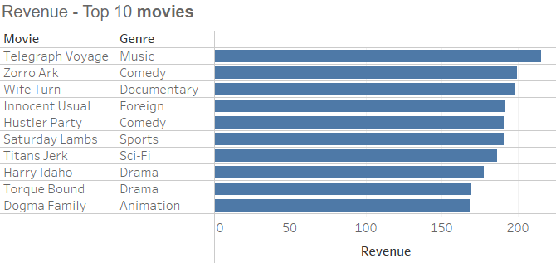
Rockbuster
Movies 1000
Countries 109
Categories 17
Rental duration 3 days(avg)
Which movies contributed the most/least to revenue gain?

Slide 4
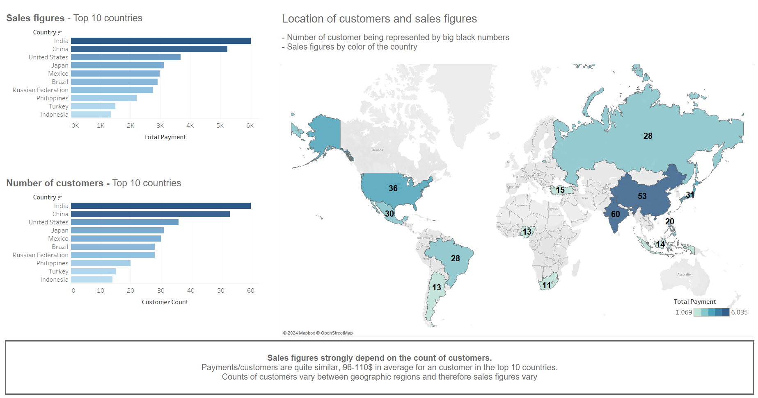
Do sales figures vary between geographic regions? Which countries are Rockbuster customers based in?

Slide 5
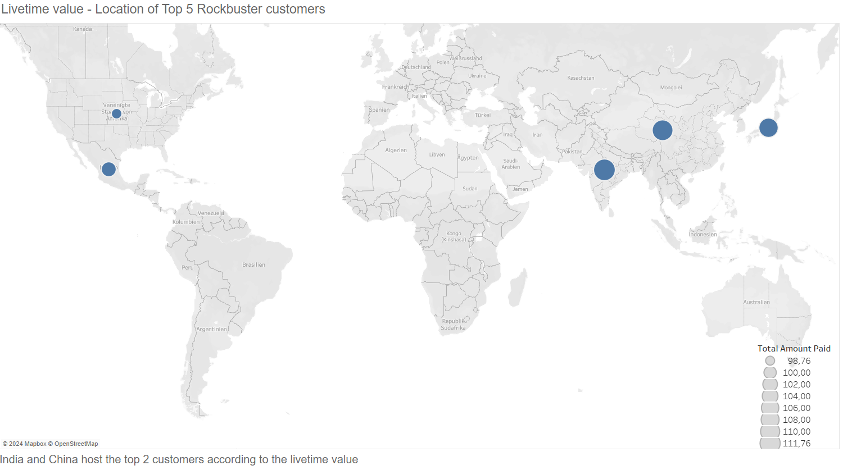
Where are customers with a high lifetime value based?

Slide 6
RecommEndations
Start in India and China
Focus on lucrative categories ‚Comedy‘ and ‚New‘
Consider to invest in Indian and Chinese movies expanding our library
Visualizations in Tableau Public

